Slide 1
Data Centre Infrastructure
CT109-3-2 and Version 2
Introduction and Overview

Slide 2
Lecturer information
Lecturer Name:
Email:
Telephone Extension:

Slide 3
Pre-requisites for this module
None

Slide 4
Aims of this module
The purpose of Data Centre Infrastructure is to provide knowledge of the various elements within a data center, the various specialisms involved, and the associated best practices.
Data center infrastructure/design requires a multi-disciplinary solution, therefore this module is not intended to give students the ability to individually manage, control or optimize all aspects of a data center design or build but to provide them with the skills to work with assistance from experts in other disciplines to deliver an overall design and efficiency strategy

Slide 5
Learning outcomes
At the end of this module, YOU should be able to:
Understand the importance of designing a data center.(MQF 1) 2.
Have the experience to design data center for different architecture and business model. (MQF 2, 6) 3.
Evaluate critically issues of data center design, data center administration, and green computing. (MQF 1, 6) 4.
Be aware of the latest developments in the field e.g. data center virtualization (MQF 1, 7)

Slide 6
Student Learning Time (SLT)
Module Credit Value:3
Total Learning Hours:
Lecture: 1.5 hours per week
Tutorial: 1.5 hours per week

Slide 7
Topics we will cover
Introduction to the data center
Site selection and environmental considerations
Architecture Design and Standards Recommendations
Raised Access Floor, connecting the infrastructure with copper and fiber.
IT Hardware
Cooling System Options and Environmental Control
Electrical Power Systems
Room Layout
Fire Protection and Security Systems
Building Automation and Energy Management Systems
Commissioning and Handover

Slide 8
What is expected of you
What is expected of you
You should abide to all the rules & regulation of APU
Proper attire
No speaking of dialects
Attendance is compulsory and valid medical certificates or letters from parents /guardians must support any absence from class.
Three lateness will be equal to one absence
All pagers and handphones should be turned off during lectures.

Slide 9
What support is available for you
Consultation hours
Resources
Reference material
Internet resources

Slide 10
How you will be assessed
COURSEWORK weighted at 50%.
An EXAM length 2 HOURS weighted at 50%.

Slide 11
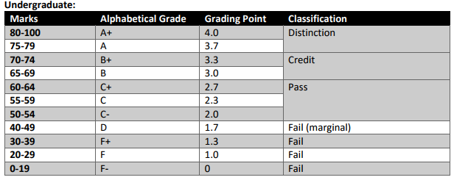
Achievement requirements

Slide 12
Question and answer session
Q & A

Slide 13
What we will cover next
Introduction to the data center

